Slide 1

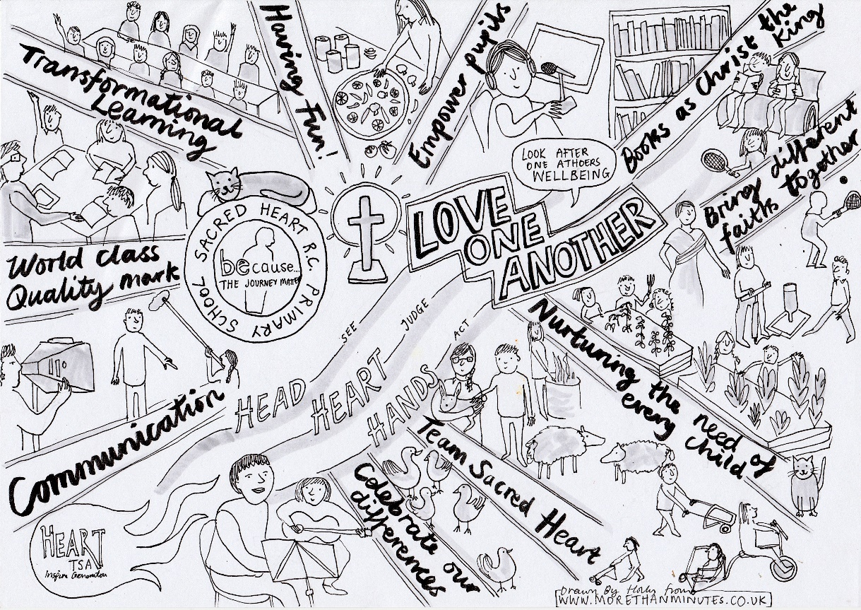
School Improvement & Development Plans
2020-2025
Last RAG rated: 2nd June 2025

Slide 2
Key priority areas for SIDP 2024-2025
CLM / CW – linked to appointment of lay chaplain and Sacred space
Religious Education – RED in place for all year groups
Reading - review of provision – ‘Are you really reading?’ approach – see separate English action plan.
All subject / aspect areas have separate and ongoing action plans

Slide 3

Focus Area 1
Catholic Life & Mission

Slide 4
Catholic identity | Target Areas | Led by | Success Criteria
Catholic Life & Mission | Pupil outcomes: the extent to which pupils contribute to and benefit from the Catholic life and mission of the school Pupil active participation to be enhanced to pre-pandemic levels. Action plans to be in place – Apostles to replace GIFT teams. Pupil ministry roles shared in hall display and be aspirational. Pupils to be pro-active in finding ways of responding to Catholic Social Teaching, locally, nationally and globally. They can clearly articulate the theology underpinning their actions. To link this to APoP. Provision: the quality of provision for the Catholic life and mission of the school To revisit mission statement with all stakeholders. (Sep 2023 and ongoing leading to Mission Week June 2025) – revisited with staff and pupils (4&5 Sep) – mission prayer draft shared with other stakeholders for comments. Known and used by all. Expanded throughout academic year, to include UIOGD aspect of Benedictine motto. Examen Prayer to be written and used by each class – Holy Week 2024. – Launched Lent 2024. To become part of spontaneous daily routine in 2024-5 academic year. To develop a dynamic and well-planned chaplaincy programme that provides extensive, creative and high- quality opportunities for the spiritual and moral development of pupils and staff. - Chapel space – Y6 room to be repurposed Sep 2024. New pupil leadership structure in place Sep 2023 to enable daily focus. Lay chaplain post from Sep 2025, with focus on community involvement – all stakeholders. Pupils to highly value the school’s revised chaplaincy provision and willingly taking leadership roles within it –children from all classes involved Sep 2023 and ongoing termly review. Leadership: how well leaders and governors promote, monitor and evaluate the provision for the Catholic life and mission of the school To develop the CSED so that the school’s self-evaluation is a coherent reflection of rigorous monitoring, searching analysis and honest self-challenge, and is clearly and explicitly focused on the Catholic life and mission of the school. This leads to well-targeted and planned improvements, often creatively conceived with key partners, to further enhance the life and mission of the school. (Au2 2023). RE lead to take weekly leadership time to focus on CSED – Sep 2023. Governing Board to have CSED as regular agenda item, contributing to and challenging linked to their independent view of the school’s provision. Pupils to contribute in a planned and systematic way to the school’s evaluation of its Catholic life and mission and take a lead in planning improvements to it. (This has begun, Au22) in relation to pupils evaluating CW each week. spread into CLM, Au1 2023. Weekly luggage tag reviews and evaluation on 4 part plans, ensure consistency via Lay chaplain involvement. Then full pupil led review in Mission week – June 2025. Pupils to report to SLT / Governing Board. | MJ / AE MJ/AE/BF MJ AE AE MJ/AE/CD AE | Working towards CSI in 2024-2025 academic year and beyond– all items in place. Pupils express joy in being members of a Catholic school community.
CSI Inspection | Headteacher (already S48 inspector) to apply and train as CSI inspector with full designation – Spring 2022 for start of CSI inspections in Diocese of Salford. To lead a CSI inspection – Au2 Term 2023 (St Edward’s, Oldham) – Su 2023 (St Peter’s, Newchurch) – Au 2023 (SAC, Burnley – 21&22 Sep2023) Sp 2023 (St Clare, Denton) Su 23 (St Joseph’s, Stacksteads). To lead other CSI inspections – Su 2024 & apply learning to school provision. To become interim CSI coordinator – Sep 2024 – QA all reports and live QA of 10% inspections per term; attend national training and meetings; lead Diocese CSI training. Lead EducareM Governance session linked to CSI challenge and support. Bring all learning back to Sacred Heart to inform practice. | MJ | Insights from training and leading inspections influence developments within school.

Slide 5
CLM | Actions | Led by | Success Criteria
AREAS ARISING FROM CSED TO TAKE INTO 2025-6 SIDP
CLM 1.6 | Extend the role of Apostles in working with selected Y4 pupils who will take on the role, being encouragers to them; Develop more explicit opportunities for pupils to explore and discern their own vocations, helping them to understand their unique call to serve God and others. | MJ | Apostles are prepared to take on the role in Y5, and understand their role of service and sacrifice. Pupils highly value the school’s chaplaincy provision, willingly taking leadership roles within it. They actively participate in and contribute to opportunities provided by the school
CLM2.8 | Provide further ways to support the spiritual and vocational discernment of both pupils and staff, building on the strong chaplaincy provision. | CD | Pupils keen to participate fully in ministry roles and take an active role in vocational discernment. The chaplaincy provision is a central and celebrated aspect of the life and mission of the school. It witnesses to the school’s commitment to the flourishing of every member of the school community, to the education of the whole person and to helping each discern their own unique vocation. As a consequence, the school has a dynamic and well-planned chaplaincy programme that provides extensive, creative and high-quality opportunities for the spiritual and moral development of pupils and staff.
CLM 3.7 | Following the success of Greg Finn’s visit, in the next academic year to celebrate more of those Catholic individuals today who influence society. | MJ | Children see Catholic values lived out by ‘non-religious’ in society who act as influencers to them. The whole of the taught curriculum, with religious education at its core, is a coherent and compelling expression of the Catholic understanding of reality. Leaders of different subject areas work together to plan opportunities to make connections between discrete subject areas that support this understanding. Opportunities have been taken, across the full breadth of the curriculum, to make choices that reflect the richness of Catholic contributions to culture.

Slide 6
Focus Area 2
Religious Education

Slide 7
Catholic identity | Target Areas | Led by | Success Criteria
Religious Education | Pupil outcomes: how well pupils achieve and enjoy their learning in religious education As a consequence of outstanding skills in religious literacy, pupils to become particularly aware of the demands of religious commitment in everyday life. Pupils to be provided opportunity to speak fluently and confidently about what they have learned in religious education, using key concepts and subject-specific vocabulary. As a consequence, they should ask incisive questions of adults and peers, which indicate an innate curiosity and a desire to deepen learning. Pupils to show notable independence in their learning; they can think for themselves, synthesizing what they have learned in original and creative ways. As a consequence, they will concentrate exceptionally well, love the challenge of learning and are curious, interested learners. Self-assessment: Pupils have a clear understanding of how well they are doing, of what they need to do to improve, and can fully articulate how they have made progress. Provision: the quality of teaching, learning and assessment in religious education Planning is linked to pupils’ current assessment and their knowledge of the individual, such that lessons consolidate and extend pupils’ knowledge and understanding, so that they learn extremely well. Teachers provide pupils with relevant and specific feedback which ensures that all pupils clearly understand what they need to do to make progress in their learning. Teachers give pupils space and time for purposeful reflection in lessons. Sep 2023 – Y1 & Y3 as part of Diocesan pilot to trial new RED curriculum – Y1 using The Vine & The Branches, Y3 using DoS model. Other classes to continue with adapted Come & See. June 2024 – All classes to trial RED from Branch 6, using Catholic Plus planning grids with Model Curriculum as a starting point. Joint staff training and workshops. Evaluate July 2024 INSET and make decisions for Sep 2024. Sep 2024 INSET – policy and way forward – model curriculum led and blended use of resources. Decision to have no CST/prayer modules as CST is integral to curriculum and RE, not add on / prayer is not RE. Ongoing review, access to DoS and wider training; incorporate Day by Day and Lighting the Path as becomes available. Ongoing triangulation, reports to GB and monitoring, supported by Associate HT – QA. Expand RE team – Sep 2024 and ongoing review. Leadership: how well leaders and governors promote, monitor and evaluate the provision for religious education Leaders to ensure a parity of demand with other core subjects in relation to whole school policies, such as homework, marking and reporting to parents. The quality of subject leadership is recognised beyond the school and the subject leader willingly shares this expertise to the benefit of other diocesan schools. Contribute to ECT training and visits; contribute to EducareM Tabor NSF visits. Leading training for DoS. New RE Directory (To know you more dearly) to be in place (published Spring 2023) - Leaders carefully plan an appropriately sequential curriculum which ensures that subject content is introduced systematically in an increasingly demanding way, as learners progress through the planned curriculum. Our RE lead has attended launch training and RED is now available to schools (Sp2023). Training to be rolled out during Au2023. We hope to begin work on the new requirements by September 2023 – explore scheme offered in part by https://wtl-tere.org/ - Y1 & Y3 now using Vine & Branches. Y3 part of Diocese pilot. see Provision, above. | AE AE CTs CTs MJ/AE MJ/AE SG AE/FD MJ MJ | Working towards CSI in 2024-2025 academic year – all items in place. RE to be the subject most pupils prefer / look forward to. Achievement in RE to be in line with RED requirements.

Slide 8
RE | Actions | Led by | Success Criteria
AREAS ARISING FROM CSED TO TAKE INTO 2025-6 SIDP
RE 1.6 | The best examples of work to be added to the class working wall in RE and a celebration book, building up a bank of work to inspire others. Each branch then to be showcased to show progression throughout the school, in a similar way to Art progression boards / frames. | FD | Consistent approach with new teachers to school. Pupils produce work of a consistently high quality, demonstrating excellent presentation, individuality and creativity. This motivates high performance from others through the modelling and displaying of excellent work.
RE 1.9 | Pupils to engage with peer review and feedback in order to further enhance learning. | FD | Build upon prior knowledge of each branch as RED is further embedded. Pupils have a clear understanding of how well they are doing, of what they need to do to improve, and can fully articulate how they have made progress.
RE 2.3 | As the RED is further embedded, and children engage with the branches again, ensure that planning is linked to pupils’ current assessment based on a check-in linked to the prior year’s knowledge expectation. | FD | Ensure adaptation of planning and flashback 4 etc. leads to more appropriate adaptation to match need. LTP to be integrated where it has potential to improve provision further. Planning is linked to pupils’ current assessment and their knowledge of the individual, such that lessons consolidate and extend pupils’ knowledge and understanding, so that they learn extremely well.
RE 2.3 | To begin to integrate ‘Lighting the Path’ resources, as they become available, into current planning, so that there continues to be a breadth of task to engage all in learning. | DC
RE 3.7 | To make further links to educational visits and visitors in RE in order to enrich learning further as full implementation of the RED is introduced by 2026. | FD | Map of visits / visitors added to CMAP. Excellent links are forged with other appropriate agencies and the wider community to provide a wide range of enrichment activities to promote pupils’ learning and engagement with religious education.
RE 3.8 | To ensure that next steps linked to adoption of Lighting the Path are carefully planned to improve outcomes, rather than just to integrate an additional resource. | DC | Leader/governor challenge and support in relation to adaptation. Leaders’ and governors’ self-evaluation of religious education demonstrates forensic monitoring, searching analysis and self-challenge. This results in strategic action and well-targeted planning which leads to outstanding outcomes.

Slide 9
Focus Area 3
Collective Worship

Slide 10
Catholic identity | Target Areas | Led by | Success Criteria
Collective Worship | Pupil outcomes: how well pupils participate in and respond to the schools’ collective worship The experiences of prayer and liturgy provided by the school engage pupils deeply and lead them to full, active and conscious participation. Pupils demonstrate this by, for example, the quality of prayerful silence, their attentiveness and response to prayer and liturgy, and their engagement in communal singing. To continue SLA with Diocese school singing programme and engage in outreach – singing in choir at St Terese of Lisieux relics @ Salford Cathedral. Introduce Class CoW books as both record and accountability measure for classes to plan, deliver and evaluate CoW. Appropriate to their age and capacity, pupils have a detailed understanding of the wide variety of ways of praying that are part of the Catholic tradition. Expand 4 part format, including CPD from M10M and 10:10. Diocesan RE innovator training – to initially use planning cards. Expand to breadth of prayer types, including visio divina. Appointment of Lay chaplain to impact upon pupil practice. Pupils work collaboratively with others, such as teachers, other pupils and chaplains to prepare creative and well-constructed experiences of prayer and liturgy. Due to the school’s provision of liturgical formation for its pupils, they can undertake liturgical ministries with confidence, understanding and skill. Pupils have a developed capacity for evaluating the quality of the prayer and liturgy they have planned and can identify how to improve next time. Full review of ministry roles in school and accountability – introduce action plans and reports to governors. Apostles to take on acolyte roles, organize prayer bags and lead SH mission challenges. Pupils readily reflect on their experience of prayer and liturgy with confidence and in detail. They can articulate clearly the ways in which these experiences have shaped how they think about themselves and the world and how this has inspired them to action. Further develop through pupil evaluation and luggage tags approach. Lay chaplain to ensure impacts upon future outcomes. Provision: the quality of collective worship provided by the school The creative and artistic skill and expertise of pupils and relevant staff have been identified, nurtured and practised to enable them to use their gifts confidently to enhance prayer and liturgy. A wide range of high-quality music and other art forms are, when appropriate, integrated into prayer and liturgy in a way that significantly enhances these experiences for participants and reflects the riches of the Church. To ensure all pupils have opportunity to showcase their gifts as a form of worship throughout the academic year. Lay chaplain to ensure skill share. The school makes imaginative and creative use of the spaces available to: − provide prayer spaces within classrooms and elsewhere that are owned by the pupils − ensure that it has access to everything that is necessary for the worthy celebration of Mass, including an appropriately sized space − create, where possible, a permanently dedicated prayer space, such as a prayer room or chapel that is cherished and regularly used by staff and students. Time and attention are regularly given over to ensure that these spaces are used appropriately, are well-cared for and are conducive to prayer. To review use of space, as previous chapel and croi too small for PLD requirements, where classrooms are not ideal due to cramped space. Invest in indoor and outdoor dedicated chapel facility and resource appropriately. Lay chaplain appointed. Spaces timetabled and pupils to assist in resourcing. It is anticipated that space may become available to develop a larger chapel space to further develop in this area – Sep 2024. Bishop John to officially bless and open – led by Apostles. Permission sought to reserve Blessed Sacrament for more spontaneous / frequent Adoration – Jan 2025 permission from Bishop John and tabernacle purchased. Relevant staff have thoughtfully planned how to work with families to include them in the prayer life of the school and to support the developing prayer life of pupils. The school works hard to secure a flourishing partnership with the local parish or parishes to help pupils participate more fully in the liturgy. Lay chaplain to encourage attendance at Stay and Pray. Review class assembly format to include morning prayer. APoP for year shared with families and community. | AE/MJ CD | Working towards CSI in 2024-2025 academic year – all items in place. Pupils to experience joy in prayer and liturgy and a breadth of provision to be used throughout the school.

Slide 11
Catholic identity | Target Areas | Led by | Success Criteria
Collective Worship (cont.) | Leadership: how well leaders and governors promote, monitor and evaluate the provision for collective worship Leaders, including governors, have planned the school calendar and timetable carefully to ensure that opportunities to celebrate the Eucharist are regularly offered to the whole school community, particularly at key times in the liturgical year and at significant moments within the life of the school. All holy days of obligation and other significant days, such as founders’ and patrons’ days, are prioritised in the school’s calendar and timetable to ensure that all those who wish to are able to participate in Mass, or other appropriate liturgies, on such days. Equally, school leaders work hard to ensure that the Sacrament of Reconciliation is offered in school at key times in the liturgical year, such as Lent and Advent. APoP in place to replace multiple separate plans, ensuring a coherent approach, with adaptations by year group and development of pupil ministry roles. Reconciliation over multiple sessions in place beyond Sacramental Programme and loved by pupils. Leaders, including governors, place the highest priority on inspirational professional development of all staff that focuses on liturgical formation and, for relevant staff, planning of prayer and liturgy; it happens frequently and is of a consistently high quality. As a result, all staff understand the centrality of prayer and liturgy to the life of the school and relevant staff are highly skilled and well supported to lead it. Mark 10 Mission – aspects used in HT modelled CoW. Develop wonder questions approach. Greg Finn to visit school – Sp 2025 & June 2025 – pupil and staff CPD. (Working mainly with Apostles). Diocesan and wider training for staff, leaders and governors. Leaders, including chaplains, are highly effective in facilitating others to plan and lead experiences of prayer and liturgy. As a consequence, pupils and staff are able to provide prayer and liturgy opportunities that are engaging, of a consistently high quality and are accessible, meaningful and relevant for the whole community. Appointment of lay chaplain. Staff CPD and monitoring in place. Coaching as needed. Leaders, including governors, place the highest priority on the evaluation of the quality and impact of prayer and liturgy and ensure it is embedded in the school’s cycle of self-evaluation and planned improvements. The voice of pupils and other relevant stakeholders are an integral and valued part of the school’s evaluation of prayer and liturgy. Regular review as part of established HT / RE reports. Gov to have presentation from CW leader and triangulate to form independent view. Investment as needed . Pupil voice received via ministry reports to GB. | AE/MJ CD MJ | Working towards CSI in 2024-2025 academic year – all items in place.
To further develop pupil led prayer and liturgy, through effective staff CPD and triangulation | INSET day introduction to new requirements – Jan 2023 / April 2023 / July 2023 / Sep 2023. Fr CD to lead PLD training INSET Jan 2025. All classes to introduce adapted pupil led worship and record book to show Gospel and planning / evaluation sheet. Monitoring and feedback. BoSCEP day led by CJM. Follow up day Nov 2023 and Diocese conference. INSET day development session to begin CJM CPD Teach us to Pray materials and agree next steps – April 2023. M10M & Greg Finn – 2023-5. Triangulation twilight Su 2023 to check planning and evaluations then at ongoing half termly twilights. Action plan by subject leads updated as a result.. Monitoring of CW – SG/AE – ‘lesson’ visits – Su1 2024 and ongoing QA, including at Pupil Progress meetings. Pupil voice – Au 2023, Su2024 and ongoing. | MJ/AE CTs MS/SG/AE | Pupils independently plan and evaluate age appropriate CW in all classes and report enjoyment of and engagement with this in pupil voice.

Slide 12
CW | Actions | Led by | Success Criteria
AREAS ARISING FROM CSED TO TAKE INTO 2025-6 SIDP
CW1.3 | To continue to grow pupil ministry roles in younger pupils, so that they are as influential as those in older classes. As more LKS2 children have taken on the role of altar server, how do they influence Y2 pupils to begin their journey through the Sacramental Programme with this outcome in mind? | CD | Younger pupils are able to articulate their ministry and development from their practice in CoW. Altar Servers to contribute to SacProg unit. Pupils work collaboratively with others, such as teachers, other pupils and chaplains to prepare creative and well-constructed experiences of prayer and liturgy. Due to the school’s provision of liturgical formation for its pupils, they can undertake liturgical ministries with confidence, understanding and skill. Pupils have a developed capacity for evaluating the quality of the prayer and liturgy they have planned and can identify how to improve next time.
Cw 2.5 | Develop an induction pack enabling parallel, experienced class teachers, to coach those new teachers starting in September 2025, so that they are enabled to become inspiring models of exemplary practice to other staff and pupils by engaging in and leading prayer and liturgy. | MJ | Induction pack on a page for new teachers (building upon Keys previously used); mentor / coach in place as appropriate for ECTs – including moderation. Staff, including senior leaders, are inspiring models of exemplary practice to other staff and pupils by engaging in and leading prayer and liturgy.
CW 3.4 | Ensure that CPD linked to prayer formation is available to those staff new to the school, enabling them to quickly be upskilled so that a consistent approach is maintained in the next academic year. | MJ | Bespoke CPD in place for new staff (from HT & Lay chaplain and mentor/coach moderation / QA & feedback) – CPLDF lead includes in annual plan. Leaders, including governors, place the highest priority on inspirational professional development of all staff that focuses on liturgical formation and, for relevant staff, planning of prayer and liturgy; it happens frequently and is of a consistently high quality. As a result, all staff understand the centrality of prayer and liturgy to the life of the school and relevant staff are highly skilled and well supported to lead it.

Slide 13


Slide 14
School Improvement & Development Plan
2022-2024
Last RAG rated: July 2024

Slide 15
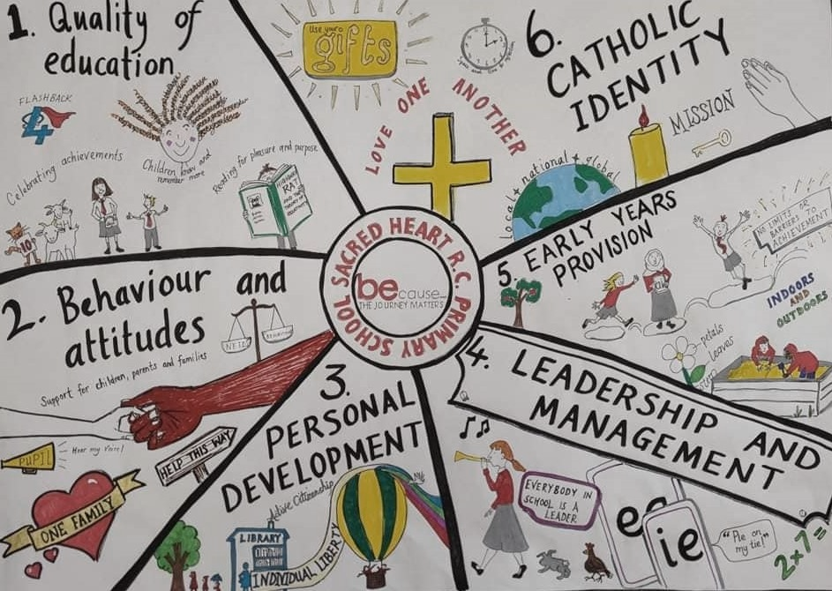

Slide 16
Focus Area 1
Quality of Education

Slide 17
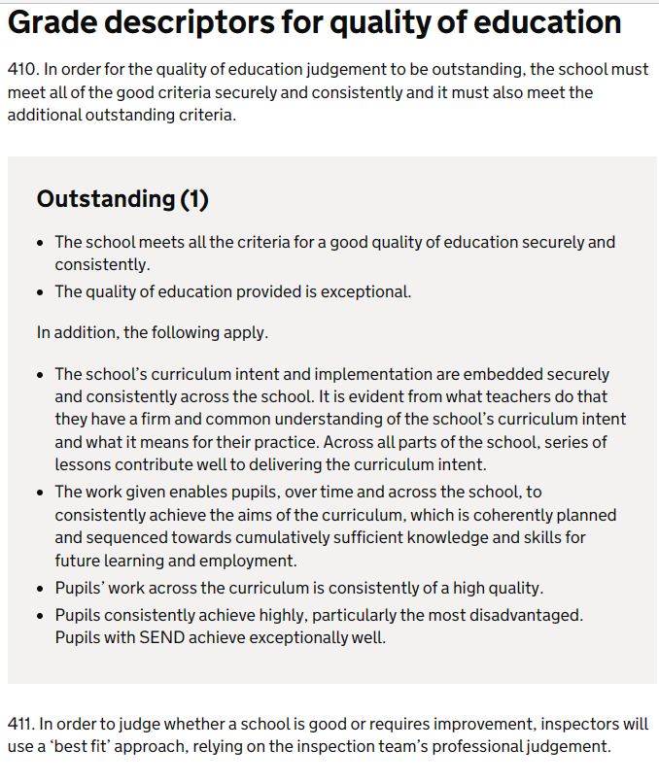
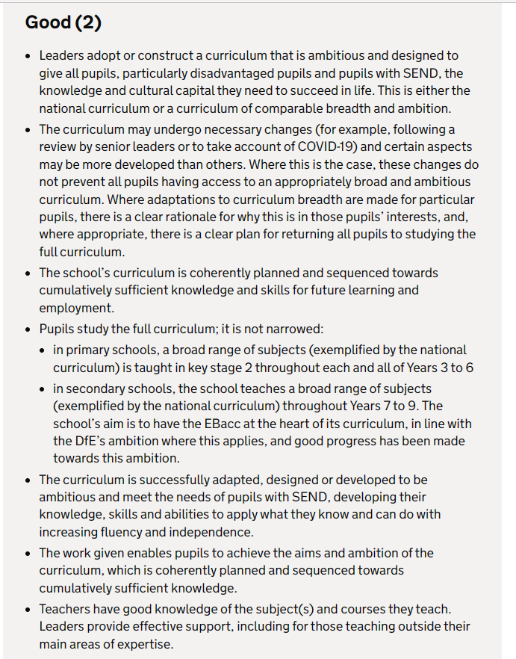
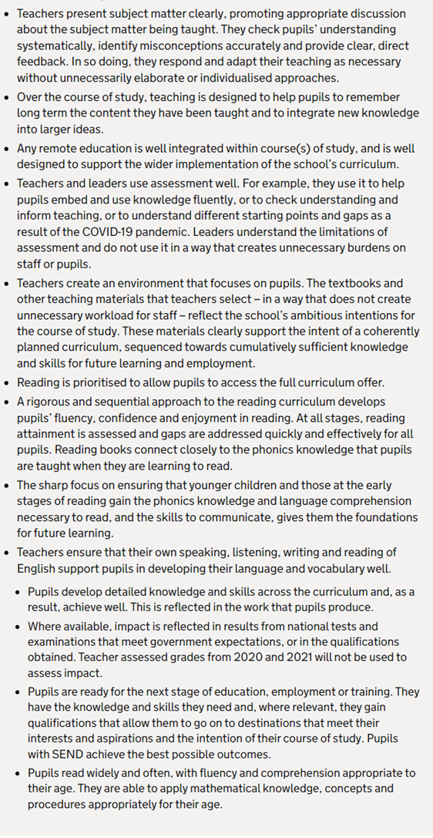

Slide 18
Quality of Education | Actions | Led by | Success Criteria
To ensure that adaptive teaching ensures significant progress for all SEND pupils in all subject areas. | Staff training on difference between differentiation and adaptive teaching – Sep 2022 INSET day & Oct 2023 staff meeting. Subject leader triangulation to review progress and extent to which adaptive teaching follows the learning objective and ensure pupils make sufficient progress in line with target setting. (Half termly triangulation twilight & monitoring cycle) – appropriate feedback leads to improvements. SLT reviews including: pupil progress meetings, lesson reviews and learning walks (in line with calendar of monitoring) INAs receive focused interventions via strategies including Education City etc. – staff training in place (Jan 2023) and impact monitored. New staff (Sep 2023) inducted to ensure above. | MJ & SB All SLs & SEND team SB & SG MS & DE | All pupils achieve expectations across curriculum – evidenced through: Tracking system Book scrutiny & feedback monitoring Pupil Progress meetings (linked to FFT 20+) Other triangulation exercises
To ensure that books reflect high standards of presentation, expectation and challenge, and that feedback results in improved outcomes. | Expectations reviewed and set at Sep 2022 & 2023 INSET day (Books – Christ the King / Coverage is…) Half termly triangulation and book monitoring with feedback acted upon. SLT regular monitoring & feedback cycle. Time is given for pupils to respond to marking – mornings extended to begin from 8:30am (ERIC) and timetables ensure focus on response. Triangulation twilights half termly to monitor this. Individualised support in place where necessary – included targeted interventions for handwriting etc. To ensure bespoke provision in place for all groups - Sep 2024. Editing strips are used consistently through school – Nov 2023. To ensure all new staff know how to use this – Sep 2023. To ensure at least fortnightly comprehension in all year groups KS1 & KS2. – By Nov 2023 | MJ & SB All SLs SB & SG All CTs All SLs All CTs | All pupil books in all subjects are of a high standard, with feedback acted upon, leading to outcomes in line with school progress meeting expectations.

Slide 19
Quality of Education | Actions | Led by | Success Criteria
To ensure that via retrieval activity and practice, including flashback four, pupils are able to demonstrate a consistency of progression across the curriculum. | All staff are confidently engaging with flashback fours in Maths curriculum – by September 2022. Reminders at INSET day, monitored in Au1 Triangulation twilight. Metacognition & retrieval practice refresher training in place (via Schoot subscription) – by January 2023. Retrieval practice in place is monitored by all subject leaders with appropriate feedback acted upon – in line with monitoring cycle & SLT reviews. Flashback Four extended to all subjects – January 2023 INSET day. Monitored in Spring Triangulation twilight and at April INSET day. To be further monitored Summer & Autumn 2023 triangulation twilights. Retrieval practice, established through sticky learning quizzes is evidenced in pupil books – by June half term 2023 and in Su2 & Autumn 2023 Triangulation twilight monitoring. | SB KA All SLs SB & SG MJ All SLs SG All SLs | All children, including SEND pupils, are able to know and remember more, securing progress in line with Pupil Progress meeting agreed targets in each year group.
For all pupils to benefit from reading for pleasure & purpose, with particular focus on the lowest 20% to ensure evidenced reading, spelling and phonics progress. | All classes to visit Westhoughton Library to promote wider reading opportunities (cycle throughout year). To ensure additional daily opportunity to read for pleasure upon early entry to school is established (early entry arrangements from Spring2 2023) and through outdoor reading opportunities. Pupil surveys to show increased enjoyment of reading. Termly. Reading comprehension further developed through school via RAMP and other strategies to ensure all pupils progress well. Y6 reading intervention after-school opportunity prioritised and appropriate lead identified (CBr) Reading champion to engage in regular data scrutiny to target pupils for intervention and ensure better progress. SLT monitoring – ongoing cycle – to provide constructive feedback to ensure pupils succeed and achieve targets identified at pupil progress. | HD/FD/GB MJ/SB SB (& JW from Su 2023) FD CBr SB SG & SB | Children, including SEND pupils, achieve their reading, spelling and phonics targets as set at Pupil Progress meetings.

Slide 20
Quality of Education | Actions | Led by | Success Criteria
To ensure an authentic, creative and relevant learning environment supports children in making effective progress and in celebrating their achievements. | Clarity of expectation – September 2022 & 2023 INSET days. All phase leaders to conduct half termly review of learning environment within their phase, with appropriate actions to follow (from Sep 2022). All Maths & English agreed working walls to be up to date and used in lessons. (By September 2022 and monitored in line with cycle). Timelines to be evidenced and visible in all classes. (By May 2024) Outdoor timelines to be extended and improved (Oct 2023) –installation by school signs. Prior terms learning to be encapsulated in retrieval displays in all classes where all subject areas are reflected in the learning environment. (By Spring / Autumn 2023.) Monitored by SL in ongoing monitoring cycle. High quality and up to date display celebrates children’s work. (reviewed termly) Like Jesus Awards extended to include writing – Sep 2023. | MJ / SB CB, FD, MW, AE SB/DE/ZA & HD,FD,GB DC DC/MJ/SBu MJ / All SLs All SLs | The learning environment, in and outside class bases, reflects the breadth of learning taking place and supports pupil learning and recall, including that for SEND pupils, enabling them to achieve FFT equivalent targets.

Slide 21
Focus Area 2
Behaviour & Attitudes

Slide 22
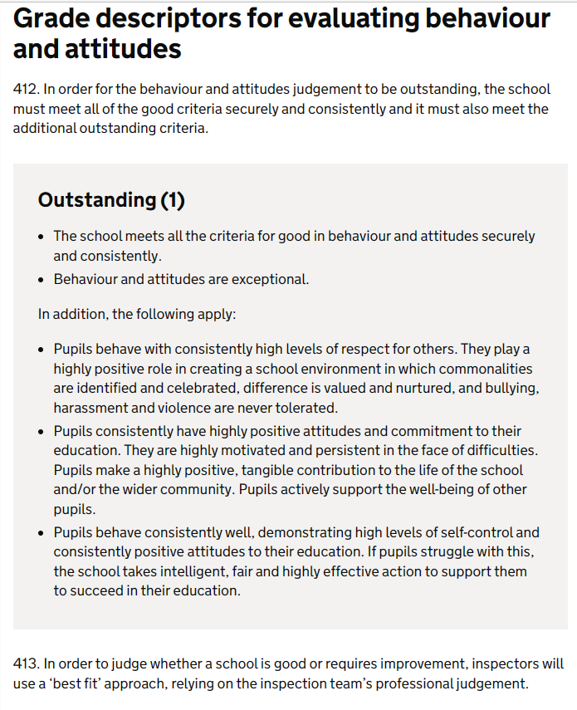
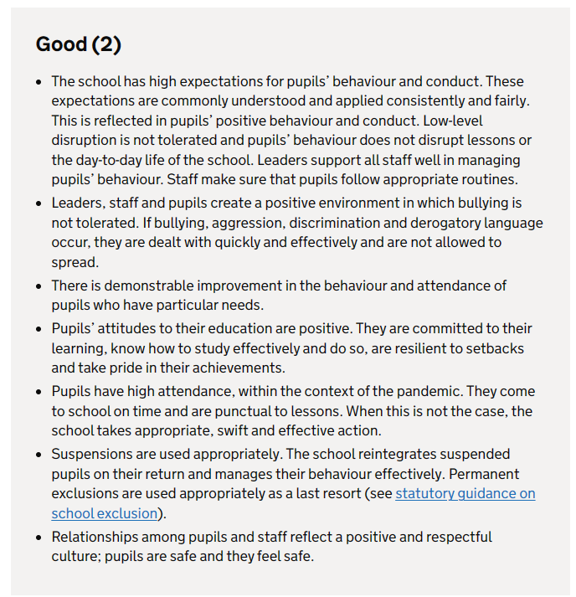

Slide 23
Behaviour & Attitudes | Actions | Led by | Success Criteria
To ensure strategies in place to support families and avoid suspension and permanent exclusion (except as a last and appropriate resort), including development of pastoral leadership. | Internal promotion of family liaison lead to SLT, in role of senior pastoral leader and DSL / attendance officer. Pastoral lead to identify priority actions and report termly to governors linked to achievement of targets. Ensure that Achieve meeting opportunities are in place to support (all but especially vulnerable / SEND) pupils and families. Evidence documented on CPOMS – monthly as advertised in newsletter. Strategies in place for all, but especially one vulnerable (SEND EHCP) LKS2 pupil, to ensure alternative provisions are accessible where possible and other interventions in place to reduce chances of suspension and permanent exclusion. (Ongoing but AP in place by Jan 2023 & transfer to specialist provision by May 2023). Following 0.4 AP for one term, behavioural support visits in place 1x p.w. funded by LA. Pupils in relevant class to understand that an identified special need is not bad behaviour – and for this to be reflected in pupil voice (by April 2023) | MJ SD SD/MS/DE MJ/MS/DE/SD Relevant CTs & SNAs MJ / CTs & support staff | Parents and families feel appropriately supported or receive the necessary available support, in a timely fashion, for their children – identified through parent voice, CPOMS records etc. (termly PV surveys ongoing). Suspension and Permanent Exclusion is avoided wherever possible, with relevant evidence of support in place in all cases. To ensure all pupils are able to learn without disturbance and understand when a special need is not ‘bad behaviour’.
To further improve break- and lunch- times through the expansion of activity including orienteering and adult expertise in leading games. | Review of Lunchtime staffing to include more TA staff – appropriate professional development meetings to take place throughout the year. Orienteering cycle to be re-organised and daily activities in place (Sep 2023) with adult and pupil leadership developed. To engage with School Health UK kitemark for lunchtime improvement – with actions appropriately implemented (April 2023 launch). Review held 20 June 2023. Review provision and action plan as part of staff member (JC) engaging with NPQLBC to impact on break and lunch provision. New behaviour policy in place in line with KCSIE changes – Sep 2023. Pupil voice termly linked to lunchtime provision. (pupil leadership in place from Sep 2023 – ongoing review) CCTV in place to ensure resolution focused enquiry. – Sep 2023. | MJ/SD SD / MW MW/MJ JC SB (JW from Su2023) | Social times offer opportunities to develop positive behaviour and attitudes and support wellbeing – seen in reduction of CPOMS incidents and pupil voice outcomes.

Slide 24
Focus Area 3
Personal Development

Slide 25
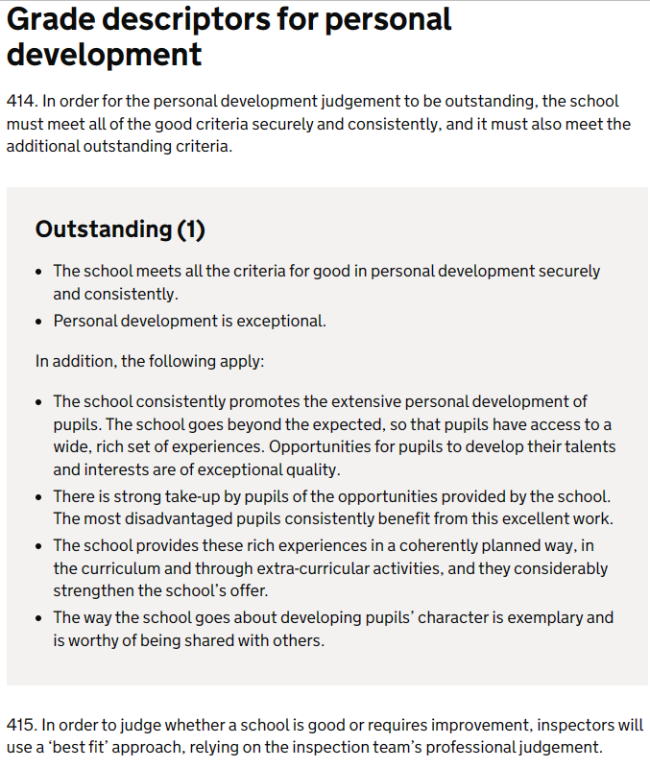


Slide 26
Personal Development | Actions | Led by | Success Criteria
To support achievement and pastoral needs through UNITE | ACHIEVE | CELEBRATE strategy. | Establish Unite meetings, termly, where that term’s CMAP is shared with parents, but also pastoral and personal development matters are discussed. (Sep 2022 and termly). Headteacher to attend all launch UNITE meetings. To run these on zoom from Sep 2023, then in person Sp/Su to ensure all have access to recordings. Meet the Teacher event in place from Sep 2023 – held 13 Sep 2023. Parents to have appropriate signposting and access to Achieve drop-in sessions as appropriate – with SENCo or Pastoral Lead. Monthly from Sep 2022. Celebration assemblies, dojos, music recitals etc. to promote extensive personal development opportunities. (From Au1 Term 2022). Additional rich opportunities for enhancement recorded in hall displays – sports and other. Updated termly at triangulation twilight by TA support staff. Extra-curricular opportunities published (and updated) for whole year on virtual office section of school website. (Sept 2022 & Sep 2023) | MJ CTs & SD, MS MS, DE, SD SB (AE from Su23), MS, SLs MJ, SB MW, BH | Pupil and parent surveys result in positive feedback for promotion of personal development, rich experiences and healthy relationships.
Promote development of active citizenship in all classes through outreach linked to planned curriculum | Pupil leadership to be celebrated in hall – with all leadership groups given opportunity to feedback to school community on a regular basis. (Spring 2023) Pupil Leaders to engage with an annual report to governors (Summer 2024– via establishment of revised pupil leadership framework – 5 Sep 2023). Partnerships with organisations such as RFK Human Rights, Comino, EducareM Building the Kingdom etc. to promote active citizenship through engagement in wider outreach and opportunity. Classes to engage, through their identified curriculum links, to local organisations (Sep2023 and monitored through subject lead cycle). Residentials have all returned, including France, Ford Castle, Kingswood & Big Sleep. | SB (AE from Su23) Staff leads for PL teams. BF BF SLs & CTs MJ, SO, SB | Character development and preparation for a life of service in modern Britain is a strength of pupil formation evidenced through pupil interview and triangulation. Reviews show development in relation to protected characteristic understanding and application.

Slide 27
Focus Area 4
Leadership & Management

Slide 28
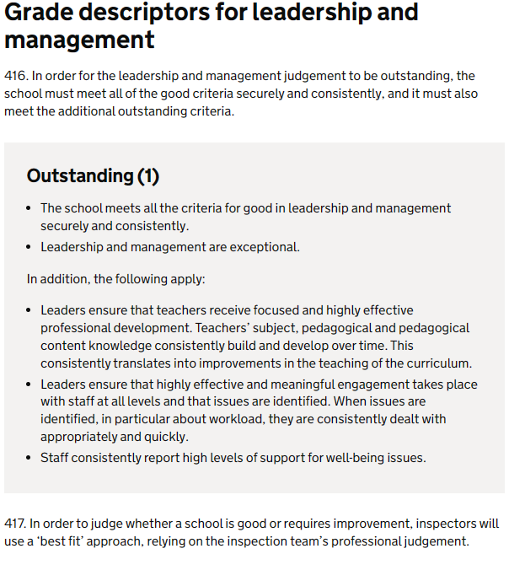
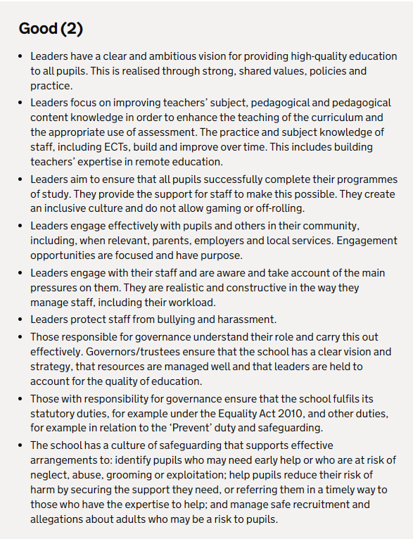
SES UPDATED 29 NOV 2022 with support from Allyson Ingall consultancy.

Slide 29
Leadership & Management | Actions | Led by | Success Criteria
To ensure that appropriate sequencing and high quality curriculum coverage results in improved attainment and progress – including Y4 multiplication check. And to ensure phonics dip in data is addressed. | Ongoing review of CMAP linked to best practice models – to ensure time is allocated to review subject association updates and relevant research and development – and to then ensure incorporation of relevant aspects in curriculum. (in line with cycle of subject leader development) Launched at Sep 2022 INSET day. Review Maths curriculum in line with changes to White Rose Maths scheme sequence (termly updates), including new WRH workbooks. Multiplication tracking to identify appropriate interventions – and review effectiveness. (Au1 2022 & 2023) Multiplication wristbands in place for all KS2+ pupils. (Au2 2022 & Au 2023) Daily LKS2 multiplication lesson in place. (Au2 2022) Interventions in place for those who did not achieve 2022 & 2023 multiplication check (Sep 2023) Additional DHT intervention as needed Su2024. Pupil Progress meetings identify target pupils and strategies to ensure achievement is met. Phonics data dip – retests July (showed 90% pass) & Sep 2023. Additional TA experienced in phonics to provide bespoke support in KS1. Sep 2023. Additional DHT intervention as needed Su2024. | MJ/SB SLs SB, DE, ZA SB, SB, ZA, DE SB SB ZA SB (FD / SG from Su23) | Pupil progress and terminal tests show pupil achievement and progress is improved – with reference to FFT20+ and equivalent.
To provide focused expectation setting, consistency and CPD for all subjects where needed, with particular reference early in the year to Music & Computing via a mentoring model. | SL triangulation to identify coaching and support needed and this to be in place before teaching point where possible. (Half termly) Programme of CPLDF established for year and adapted as necessary through SL and wider staff interaction with CPDF lead (BT). Autumn term 2022 team teaching and coaching plan in place for Music, led by SL (MS) with some transition into Spring Term 2023 where needed. To monitor impact following this CPD. Au 23. Computing mentoring model in place led by subject leader (BT) during Autumn 2022 & Spring 2023 Terms. To monitor impact Au 2023. | SB & SLs BT MS BT | Consistency in approach to teaching is achieved in all areas through ongoing professional development and support strategies.

Slide 30
Leadership & Management | Actions | Led by | Success Criteria
Bespoke CPLDF (including subscription to https://www.schoot.co.uk/ ) to lead to greater impact for subject leaders and all staff. | Programme of CPLDF bespoke to individuals set out and time allocated within staff meeting time and subject lead time. Subject leaders to access deep dive training (Au2022) Staff wellbeing prioritised through reference to EEF research base and documentation (Display Au2022). Staff surveys – termly from Au2022. Prioritise metacognition development through a TLR3 fixed term post. | BT MJ/SB (surveys – JW from Su23) KA | Staff receive focused development and as a result better implement the curriculum, leading to achieved pupil outcomes.
To seek external validation of subject / aspect areas through reviews, kite-marks and benchmarking as a tool for school improvement. | Ongoing cycle of reviews linked to kitemarks: FairTrade Achiever – Sep22 Primary Science Quality Mark Outreach – Sep22 International Schools Award – Sep22 Early Years Quality Mark – Nov22 AfPE Quality Mark – Nov22 UNICEF Rights Respecting Schools Silver – Dec22 Basic Skills Quality Mark – Mar23 Geography Primary Quality Mark –Jun23 RE Quality Mark – Jun23 School Games – Jul23 ArtsMark – Mar24 Eco Green Flag – Sep24 (new leader so begin work this academic year) | MJ SLs | Leaders have an ambitious vision, and respond to necessary improvement areas leading to improved outcomes and wider opportunities for pupils.

Slide 31
Leadership & Management | Actions | Led by | Success Criteria
Engage with NLE work & develop outreach opportunities | Headteacher to attend NLE induction and complete online study. (From Dec 2022). Headteacher to successfully complete NLE commissions allocated by DFE. (From April 2023) School to become EducareM Hub for North School to become RFK Human Rights Primary Hub School to extend ITT programme by engaging with OLP Best Practice Network (as well as University of Cumbria) – in place Sep 2023 – to review impact Dec 2023. | MJ MJ MJ BF BF/MJ | School is rewarded by income to enable wider opportunities for pupils and development of leaders within school.
Strategic plan for teacher / leader maternity leaves ensures that there is a seamless transition. | HD Mat Leave from Nov2022– internal cover by DS (to Dec 2023), initially in Y1 then KS2 from Dec 2023 –part time Tue-Thur. Establish consistency lead role upon return Jan-July2024 (part time). SB (DHT) Mat Leave – BT to provide some further Y6 morning support & futher ½ day for PPA& leadership time allocation; roles allocated to existing TLR2 postholders: AE - Tracking and assessment FD – Pupil Progress CB – Parental partnership JW – Voice surveys KA Mat Leave – internal cover by MS (from Su2 2023) then ECT appointment from Sep 2023 for one year (appointment made Feb 2023) SB (SBM) Mat Leave due to begin Dec 2023. To re-organise office workload. Appointment in process linked to BH promotion – March2024. EYFS TA maternity leave (Au2 2022) covered internally by apprentice – to keep under review. Support to be in place from EYFS lead. Staff member returned Sep 2023. Further Matleave July 2024 – JW. Retain exisiting two temp contract teachers – achieved Mar2024 (to Aug2025) | MJ MJ MJ SB/MJ CB | All roles covered ensure that pupils make planned level of progress. Staff development opportunities are taken to ensure retention.

Slide 32
Focus Area 5
Early Years Provision

Slide 33
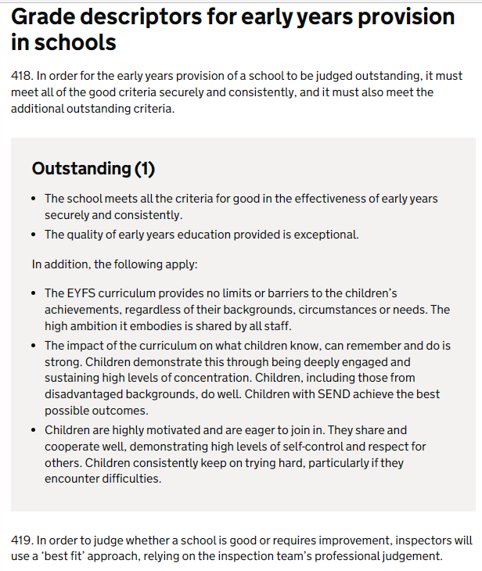
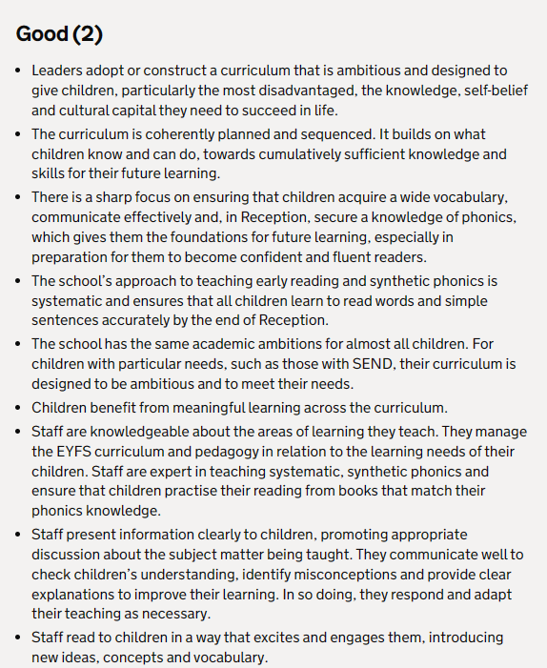
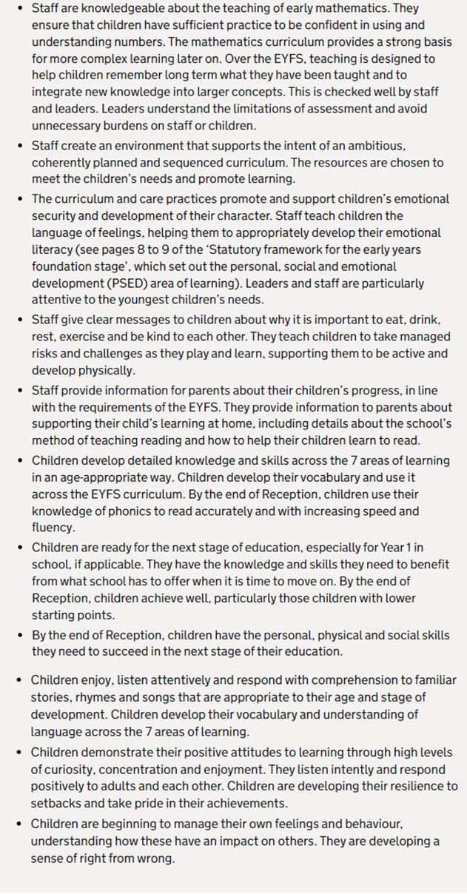
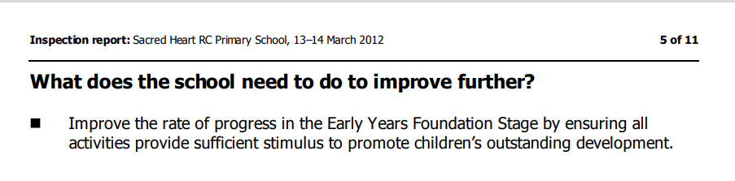

Slide 34
Early Years Provision | Actions | Led by | Success Criteria
Ensure sharp focus on vocabulary development, including in the outdoor provision | Commission EY review from Learning Together Trust (Dec2022), with appropriate actions taken following report. Review from Laura Wright – LA – Nov 2023, Jan 2024– targets achieved to Jan 2024. – review in May 2024 Focus on development of communication, language and literacy development, especially access to vocabulary and adult / pupil intervention when outdoors. | MJ SG CB, RR | The learning environment supports the intent of an ambitious curriculum and the associated vocabulary is in view, reinforced and used by adults and pupils., leading to improved outcomes.
Review resources chosen to meet children’s needs and promote curricular learning, in particular in the outdoor provision | Ongoing development and refining of curriculum offer in EYFS (Sep 2022). Develop the outdoor provision to include clearly defined areas that promote the EYFS curriculum, specifically incorporating early reading and early maths. Develop the opportunities for forest school provision for children to consolidate learning. | CB | EYFS curriculum provides no limits or barriers to children’s achievements. As a result, all children, including those with SEND, achieve well.

Slide 35
Focus Area 6
Catholic identity

Slide 36
Catholic identity | Target Areas | Led by | Success Criteria
Catholic Life & Mission | Pupil outcomes: the extent to which pupils contribute to and benefit from the Catholic life and mission of the school Pupil active participation to be enhanced to pre-pandemic levels. Action plans to be in place. Pupils to be pro-active in finding ways of responding to Catholic Social Teaching, locally, nationally and globally. They can clearly articulate the theology underpinning their actions. Provision: the quality of provision for the Catholic life and mission of the school To revisit mission statement with all stakeholders. (Sep 2023) – revisited with staff and pupils (4&5 Sep) – mission prayer draft shared with other stakeholders for comments. Known and used by all. Examen Prayer to be written and used by each class – Holy Week 2024. – Launched Lent 2024. To develop a dynamic and well-planned chaplaincy programme that provides extensive, creative and high- quality opportunities for the spiritual and moral development of pupils and staff. - Chapel space – Y6 room to be repurposed Sep 2024. New pupil leadership structure in place Sep 2023 to enable daily focus. Pupils to highly value the school’s revised chaplaincy provision and willingly taking leadership roles within it –children from all classes involved Sep 2023. Leadership: how well leaders and governors promote, monitor and evaluate the provision for the Catholic life and mission of the school To develop the CSED so that the school’s self-evaluation is a coherent reflection of rigorous monitoring, searching analysis and honest self-challenge, and is clearly and explicitly focused on the Catholic life and mission of the school. This leads to well-targeted and planned improvements, often creatively conceived with key partners, to further enhance the life and mission of the school. (Au2 2023). RE lead to take weekly leadership time to focus on CSED – Sep 2023. Pupils to contribute in a planned and systematic way to the school’s evaluation of its Catholic life and mission and take a lead in planning improvements to it. (This has begun, Au22) in relation to pupils evaluating CW each week and now must spread into CLM, Au1 2023) | MJ / AE MJ/AE/BF MJ AE AE MJ/AE AE | Working towards CSI in 2024-2025 academic year – all items in place.
CSI Inspection | Headteacher to apply and train as CSI inspector with full designation – Spring 2022. To lead a CSI inspection – Au2 Term 2023 (St Edward’s, Oldham) – Su 2023 (St Peter’s, Newchurch) – Au 2023 (SAC, Burnley – 21&22 Sep2023) Sp 2023 (St Clare, Denton) To lead other CSI inspections – Su 2024 & apply learning to school provision. To become interim CSI coordinator – Sep 2024 | MJ | Insights from training and leading inspections influence developments within school.

Slide 37
Catholic identity | Target Areas | Led by | Success Criteria
Religious Education | Pupil outcomes: how well pupils achieve and enjoy their learning in religious education As a consequence of outstanding skills in religious literacy, pupils to become particularly aware of the demands of religious commitment in everyday life. Pupils to be provided opportunity to speak fluently and confidently about what they have learned in religious education, using key concepts and subject-specific vocabulary. As a consequence, they should ask incisive questions of adults and peers, which indicate an innate curiosity and a desire to deepen learning. Pupils to show notable independence in their learning; they can think for themselves, synthesizing what they have learned in original and creative ways. As a consequence, they will concentrate exceptionally well, love the challenge of learning and are curious, interested learners. Self-assessment: Pupils have a clear understanding of how well they are doing, of what they need to do to improve, and can fully articulate how they have made progress. Provision: the quality of teaching, learning and assessment in religious education Planning is linked to pupils’ current assessment and their knowledge of the individual, such that lessons consolidate and extend pupils’ knowledge and understanding, so that they learn extremely well. Teachers provide pupils with relevant and specific feedback which ensures that all pupils clearly understand what they need to do to make progress in their learning. Teachers give pupils space and time for purposeful reflection in lessons. Leadership: how well leaders and governors promote, monitor and evaluate the provision for religious education Leaders to ensure a parity of demand with other core subjects in relation to whole school policies, such as homework, marking and reporting to parents. The quality of subject leadership is recognised beyond the school and the subject leader willingly shares this expertise to the benefit of other diocesan schools. New RE Directory (To know you more dearly) to be in place (published Spring 2023) - Leaders carefully plan an appropriately sequential curriculum which ensures that subject content is introduced systematically in an increasingly demanding way, as learners progress through the planned curriculum. Our RE lead has attended launch training and RED is now available to schools (Sp2023). Training to be rolled out during Au2023. We hope to begin work on the new requirements by September 2023 – explore scheme offered in part by https://wtl-tere.org/ - Y1 & Y3 now using Vine & Branches. Y3 part of Diocese pilot. | AE AE CTs CTs AE MJ/AE AE | Working towards CSI in 2024-2025 academic year – all items in place.

Slide 38
Catholic identity | Target Areas | Led by | Success Criteria
Collective Worship | Pupil outcomes: how well pupils participate in and respond to the schools’ collective worship The experiences of prayer and liturgy provided by the school engage pupils deeply and lead them to full, active and conscious participation. Pupils demonstrate this by, for example, the quality of prayerful silence, their attentiveness and response to prayer and liturgy, and their engagement in communal singing. Appropriate to their age and capacity, pupils have a detailed understanding of the wide variety of ways of praying that are part of the Catholic tradition. Pupils work collaboratively with others, such as teachers, other pupils and chaplains to prepare creative and well-constructed experiences of prayer and liturgy. Due to the school’s provision of liturgical formation for its pupils, they can undertake liturgical ministries with confidence, understanding and skill. Pupils have a developed capacity for evaluating the quality of the prayer and liturgy they have planned and can identify how to improve next time. Pupils readily reflect on their experience of prayer and liturgy with confidence and in detail. They can articulate clearly the ways in which these experiences have shaped how they think about themselves and the world and how this has inspired them to action. Provision: the quality of collective worship provided by the school The creative and artistic skill and expertise of pupils and relevant staff have been identified, nurtured and practised to enable them to use their gifts confidently to enhance prayer and liturgy. A wide range of high-quality music and other art forms are, when appropriate, integrated into prayer and liturgy in a way that significantly enhances these experiences for participants and reflects the riches of the Church. The school makes imaginative and creative use of the spaces available to: − provide prayer spaces within classrooms and elsewhere that are owned by the pupils − ensure that it has access to everything that is necessary for the worthy celebration of Mass, including an appropriately sized space − create, where possible, a permanently dedicated prayer space, such as a prayer room or chapel that is cherished and regularly used by staff and students. Time and attention are regularly given over to ensure that these spaces are used appropriately, are well-cared for and are conducive to prayer. It is anticipated that space may become available to develop a larger chapel space to further develop in this area. Relevant staff have thoughtfully planned how to work with families to include them in the prayer life of the school and to support the developing prayer life of pupils. The school works hard to secure a flourishing partnership with the local parish or parishes to help pupils participate more fully in the liturgy. | AE | Working towards CSI in 2024-2025 academic year – all items in place.

Slide 39
Catholic identity | Target Areas | Led by | Success Criteria
Collective Worship (cont.) | Leadership: how well leaders and governors promote, monitor and evaluate the provision for collective worship Leaders, including governors, have planned the school calendar and timetable carefully to ensure that opportunities to celebrate the Eucharist are regularly offered to the whole school community, particularly at key times in the liturgical year and at significant moments within the life of the school. All holy days of obligation and other significant days, such as founders’ and patrons’ days, are prioritised in the school’s calendar and timetable to ensure that all those who wish to are able to participate in Mass, or other appropriate liturgies, on such days. Equally, school leaders work hard to ensure that the Sacrament of Reconciliation is offered in school at key times in the liturgical year, such as Lent and Advent. Leaders, including governors, place the highest priority on inspirational professional development of all staff that focuses on liturgical formation and, for relevant staff, planning of prayer and liturgy; it happens frequently and is of a consistently high quality. As a result, all staff understand the centrality of prayer and liturgy to the life of the school and relevant staff are highly skilled and well supported to lead it. Leaders, including chaplains, are highly effective in facilitating others to plan and lead experiences of prayer and liturgy. As a consequence, pupils and staff are able to provide prayer and liturgy opportunities that are engaging, of a consistently high quality and are accessible, meaningful and relevant for the whole community. Leaders, including governors, place the highest priority on the evaluation of the quality and impact of prayer and liturgy and ensure it is embedded in the school’s cycle of self-evaluation and planned improvements. The voice of pupils and other relevant stakeholders are an integral and valued part of the school’s evaluation of prayer and liturgy. | AE | Working towards CSI in 2024-2025 academic year – all items in place.
To further develop pupil led prayer and liturgy, through effective staff CPD and triangulation | INSET day introduction to new requirements – Jan 2023 / April 2023 / July 2023 / Sep 2023. All classes to introduce pupil led worship and record book to show Gospel and planning / evaluation sheet. BoSCEP day led by CJM. Follow up day Nov 2023. INSET day development session to begin CJM CPD Teach us to Pray materials and agree next steps – April 2023. Triangulation twilight Su 2023 to check planning and evaluations. Monitoring of CW – MJ/AE – ‘lesson’ visits – Su1 2024 Pupil voice – Au 2023. | MJ/AE CTs MS/MJ/AE | Pupils independently plan and evaluate age appropriate CW in all classes and report enjoyment of and engagement with this in pupil voice.

Slide 41
School Improvement & Development Plan
2021-2022
Last RAG rated:

Slide 42
Focus Area 1
Catch-up & Keep-up
Targeted academic support

Slide 43
Catch-up & Keep-up | Actions | Led by | Timescale | Success Criteria
Government catch-up designated funding is used effectively to enable pupils to be on track to achieve end of KS FFT20 targets | 1. Inclusion leader released from class for year to deliver programme. 2. Pupil Progress (PP) leader to establish implementation plans, identifying pupils for intervention, reviewing on regular basis. 3. Implementation plan published to website. 4. Ensure impact when blended provision in place. 5. PP lead to Monitor impact. | SM MS | 1) ‘Recovery Programme’ set up and running from October 2021 and will continue until July 2022. PP lead monitors impact and adjusts the list of pupils after a pupil progress meeting at the end of each half term. This is ongoing until July 2022. | Pupils identified for intervention are enabled to catch-up, with ongoing evidence leading to success in formal data-drops. (e.g Phonics screening outcomes). End of Year Target for 2021-22 is 80% to achieve ELG in EYFS; 98% to pass phonics screening check in Y1; 94% to pass phonics screening check in Y2; 80% to achieve National Standard in Y2 with 27% to achieve combined above NS; 88%+ to achieve NS combined in Y6 with 34% to achieve combined above NS (FFT 20).
Covid return plan in place to enable educators to enable effective face-to-face, blended and remote curriculum delivery and assessment. | Google Classroom set up. Staff training. Initial day 1 work to be uploaded to G Classroom for pupils on day 1 of isolation. Full blended and remote offer to include daily registration and wellbeing check for all year groups. Blend of learning experiences to include daily recorded or live lesson for all year groups in event of lockdown. Key worker provision to follow all government guidelines. Information and communication to parents is timely and appropriate. | SM MJ | 1) Completed before September 2021. 2) Completed on Staff INSET day September 2021 3) Completed during the first week of term in September 2021 4, 5, 6 and 7) This will come into effect if bubble closures are reintroduced due to an outbreak of Covid-19 (ongoing). | All children are enabled to continue their education in the event of bubble closure, isolation or lockdown. Children make the expected progress and reach their end of year target. End of Year Target for 2021-22 is 80% to achieve ELG in EYFS; 98% to pass phonics screening check in Y1; 94% to pass phonics screening check in Y2; 80% to achieve National Standard in Y2 with 27% to achieve combined above NS; 88%+ to achieve NS combined in Y6 with 34% to achieve combined above NS (FFT 20).

Slide 44
Catch-up & Keep-up | Actions | Led by | Timescale | Success Criteria
Curriculum coverage maintains delivery of all subjects whilst ensuring gaps are closed. | All subjects to be taught in curriculum from September 2021 in line with revised CMAP and associated planning. Curriculum imbalance for KS1 + pupils to enable phonics catch up. Books as ‘Christ the King’ strategy rolled out with appropriate monitoring in place to ensure consistency, progression and presentation are prioritised. Curriculum Progress meetings / Pupil Progress meetings to focus on developmental improvements and consistency of approach throughout school. Monitoring in place to ensure impact. | SM MJ SG All class teachers & support staff | Week monitoring of curriculum coverage began from October 2021 and is ongoing until July 2022. | Curriculum coverage is achieved and quality of work in books works towards expected standard by end of Spring Term 2021. Children make expected progress and reach their end of year target. End of Year Target for 2021-22 is 80% to achieve ELG in EYFS; 98% to pass phonics screening check in Y1; 94% to pass phonics screening check in Y2; 80% to achieve National Standard in Y2 with 27% to achieve combined above NS; 88%+ to achieve NS combined in Y6 with 34% to achieve combined above NS (FFT 20).
Behavioural policy is fit for purpose during covid-return. | Behavioural Policy is appropriate for return to education with our dojo point system that reflects our Jesuit Values: Respect, Unity, Perseverance, Enthusiasm, Self-Control and Knowledge and Wisdom. Memorable moments award is established, promoting sharing of learning on social media, promoting parental engagement. Staff CPDF linked to parental engagement – Jan 2021 | SM MJ | Class Dojo system set up and staff trained on how to use it during the September 2021 INSET day. Memorable Moments trophy is ongoing to July 2022. Staff CPDF – Jan 2021 | Pupil engagement is improved following period of school closure and focused on learning behaviours and presentation.

Slide 45
Catch-up & Keep-up | Actions | Led by | Timescale | Success Criteria
KOs, Sticky learning | Knowledge Organisers are effectively used to promote key vocabulary and new learning. Knowledge Week established to show progress (knowing and remembering more). Sticky learning post-it to be used in all classes and attached to door-window to promote knowledge retention. Staff CPDF linked to knowledge retention. | SM MW MJ | Created during lockdown March-July 2020 and implemented in September 2021. Monitoring of their effectiveness is completed by subject leads during triangulation activities each half term and during knowledge week at the end of term until July 2022. Knowledge weeks began from September 2020 and they take place each half term during until July 2022. Sticky learning display resources ready for September 2021 and the display is added to throughout the year until July 2022. 4) Spring Term 2021 – Twilight/Staff meeting CPDF for staff. | Progress is evidenced at Pupil Progress and Curriculum Progress meetings. Pupil interviews and pupil survey show knowledge is retained.
Appraisal targets and systems promote high standards in covid catch-up. | All teacher appraisal targets to focus on catch-up and ensure accountability is clear. Monitoring in place to ensure support / intervention when necessary. | HD | 1) Before end of October 2021 | Staff are focused on meeting curricular targets and ensuring progress for all pupils.

Slide 46
Education Recovery | Actions | Led by | Timescale | Success Criteria
Education recovery for children in the EYFS is focused and ensures successful outcomes. | Staff in EYFS understand strategies they can use to support education recovery. Baseline is accurately taken, with clear actions agreed at Pupil Progress meetings. Focus on summer born pupils and vulnerable groups. Mid point assessments to identify where early intervention is needed. | DE RR SM MS | 1.) Strategies to be in place for September 2021 and reviewed at least half termly until July 2022. 2.) Baseline assessment completed within the first 6 weeks of term (October 2021) 3.) Strategies to be in place for September 2021 and reviewed at least half termly until July 2022. 4) Pupil progess meeting December 2021. | Children in EYFS achieve outcomes in line with the school’s targets. End of Year Target for 2021-22 is 80% to achieve ELG in EYFS.
Covid recovery premium ensures that the difference is diminished for our most disadvantaged pupils. | Covid Recovery Premium statement is regularly reviewed, uploaded to website and focuses on an evidence based approach for supporting the most disadvantaged pupils. MS released to deliver specific and focused intervention. National Tutoring Programme established with target students and impact monitored. Pupil Progress meetings to monitor impact, inform next steps and agreed actions to be taken. Most disadvantaged pupils are supported through a range of intervention to achieve their FFT targets. Family Liaison Officer, Caritas social worker, Focus Intervention Teacher and TA support is focused effectively on agreed targets. | SM / MS SM/MS SM SM SM/MS SD/VR/SM/MS | 1.) To be reviewed again in Dec 2022 and at the end of each term. 2) Ongoing from October 2021-July 2022. 3) 23rd November – 1st March 2022 4) PP Meetings are the week before half term (ongoing until July 2022) 5) Ongoing until July 2022 6) Ongoing until July 2022 | Most disadvantaged pupils show accelerated progress in order to achieve FFT targets. End of Year Target for 2021-22 is 80% to achieve ELG in EYFS; 98% to pass phonics screening check in Y1; 94% to pass phonics screening check in Y2; 80% to achieve National Standard in Y2 with 27% to achieve combined above NS; 88%+ to achieve NS combined in Y6 with 34% to achieve combined above NS (FFT 20).

Slide 47
Education Recovery | Actions | Led by | Timescale | Success Criteria
Focused intervention results in children achieving their FFT Targets | All teachers and support staff to be focused on their contribution to recovery: Teachers to identify and action specific targets agreed at Pupil Progress meetings. SENDCo to deliver appropriately challenging and ambitious recovery programme. FLO to ensure engagement is high including in the home setting to ensure all are working to the same goal. TAs lead focused interventions for relevant pupils with impact monitored by class teacher and DHT via PP meetings. Google Classroom is utilised to ensure those learning from home do not fall behind, with live lessons able to be accessed by children isolating. Phonics strategy agreed at PP meetings to support those hard-to-reach pupils in KS1, particularly Y2 in lead up to phonics screening check. Improve mental maths fluency, particularly in LKS2 through daily focused multiplication mental and oral input. Pupils targeted for specific intervention, clubs to develop skill – e.g. handwriting peer-peer support pupil led club – monitor impact at pupil progress meetings Pupils taking end of KS assessments are enabled to meet targets through focused intervention – e.g. Y6 master-classes, Parent meetings etc. | SM MS SD SM SM HD SM SD/SM/DE SM | End of September/Early October 2021 Established by October 2021 and continued until July 2022. Established from September 2021 and continued until July 2022. Established from September 2021 and continued until July 2022. Established from September 2021 and continued until July 2022. Established from September 2021 and continued until July 2022. From December 2021 following staff CPDF linked to Maths Hub project and continued until July 2022. Spring term 2022 and continued until July 2022. Reception, Y2 and Y6 Maths meetings Autumn term 2021, reading meetings R, Y2 and Y6 spring term 2022. | All pupils achieve their FFT targets. Y2 phonics screening check – 98% to pass phonics screening check in Y1 (June 2022); 94% to pass phonics screening check in Y2. Y4 multiplication check – our target is 95% to pass the multiplication check. End of Year Target for 2021-22 is 80% to achieve ELG in EYFS; 98% to pass phonics screening check in Y1; 95% to pass phonics screening check in Y2; 80% to achieve National Standard in Y2 with 27% to achieve combined above NS; 88%+ to achieve NS combined in Y6 with 34% to achieve combined above NS (FFT 20).

Slide 48
Focus Area 2
Subject Leadership
& Curriculum

Slide 49
Subject Leadership & Curriculum | Actions | Led by | Timescale | Success Criteria
Subject leaders engage with deep dives to ensure their subject is consistently taught throughout school and that coverage is achieved. | Subject leaders are allocated specific developmental time to work with SG to focus on targets for their subject area. Focus changed Jan 2020 – October 2021 to lesson observations - SG INSET Twilights throughout the year focus on triangulation of subject evidence and feedback to staff. Curriculum evolves to ensure appropriate guidance and CPDF is in place to guarantee a consistency and high quality implementation throughout school. | SM SG Subject leaders | 1) Established by September 2020 and continued until July 2022. 2) Starting from September 2021, the third Wednesday evening of each half term is a Twlight session focussed on triangulation of subject evidence and feedback to staff. 3) Curriculum map revised and shared by September 2021 and CPDF delivered on September INSET 2021, CPDF continued during weekly staff meeting ‘workshops’ until July 2022. | All subjects show high quality outcomes and consistency of delivery.
RSHE is taught to a high standard throughout school. | Policy is in place, based on CES model, and approved by Diocese & Governing Board. Life to the Full & Speak Truth to Power CPDF is delivered to all teachers. Implementation plan is in place with all year groups involved as relevant. Appropriate recording is in place to enable subject leader triangulation. Website is updated with new policy and curriculum materials. Monitoring ensures CESEW & DFE criteria are met. | JC BF | 1, 2, and 3) Established by September 2020 and continued until July 2022. 4) Established by September 2020 and monitoring is ongoing until July 2022. 5) Jan 2022 6) Criteria are shared and in place by September 2020 and monitoring is ongoing until July 2022. | RSHE triangulation shows impact on pupil progress.

Slide 50
Subject Leadership & Curriculum | Actions | Led by | Timescale | Success Criteria
Catholic Social Teaching is promoted throughout the curriculum offer (in line with intent statement). | Staff CPDF and Building the Kingdom involvement promotes children as ‘Gospel Activists’ at all stages, and explores how to achieve this through the Pastoral Cycle (SEE-JUDGE-ACT | UNDERSTAND-DISCERN-RESPOND | HEAD-HEART-HANDS) approach linked to the new RE Curriculum Directory. Community links promote a living Catholic faith and mission. Curriculum Progress meetings engage teachers and monitor impact. Subject leader triangulation is focused on Intent-Implementation-Impact. | MJ AE YB All subject leaders | CPDF completed by staff during the academic year 2019-2020 and 2020-2021 and new staff are enrolled to complete the course this academic year (2021-2022). 2, 3 and 4) To be in place for October 2021 and monitored throughout the academic year. | The school’s values are incorporated at all levels into curriculum delivery.
Action Plans for each subject / aspect are in place and lead to school improvement. | Subject / aspect action plans are continually reviewed and evaluated. Termly reports to Governing Board focus on progress and key areas for next step development. Individual action plans are in place where needed, and developmental feedback given to teachers and improvement monitored appropriately. Subject / aspect association membership & CPDF, and associated kite-marks focus subject leaders and all educators on best and next practice. Appraisal is linked to achievement and impact of subject / aspect leadership. | MJ SM HD All subject leaders | Action plans are reviewed at each Twilight meeting (3rd Wednesday of each half term). Action plans Established by September 2020 and reviewed half termly until July 2022. | Subject delivery promotes engagement, progress and coverage in all year groups, with timely intervention where necessary.

Slide 51
Subject Leadership & Curriculum | Actions | Led by | Timescale | Success Criteria
EYFS is of a high quality to ensure building blocks in place for KS1 and 2. | New EYFS lead has a clear action plan in place and works with the new EYFS team to ensure high quality teaching and learning at all times. Focus on outdoor learning – through appropriate CPDF including forest school training. New gov.uk EYFS requirements are in place. | CTW RR SG | Established by September 2020 and continued until July 2022. Portfolio is due to be handed in in April 2022 (Forrest School) | Children are progressing well in EYFS and meet their end of year target (80% to meet ELG).

Slide 52
Subject Leadership & Curriculum | Actions | Led by | Timescale | Success Criteria
Children have access to a well-developed curriculum that enables them to know & remember more. | Subject leadership teams strengthened by staff new to the school. Subjects undergo annual review and CMAP update in line with most recent subject association research and advice. Phonics strategy review – replacement scheme for letters and sounds is decided upon and in place. Triangulation ensures that a consistency of approach is achieved through focused feedback and support. Quality assurance – internal and external reviews measure progress. Pupil progress meetings are linked to pupil achievement of targets in all subject areas. Bespoke CPD is in place where required in all subjects and linked to CMAP developments. Work towards subject kitemarks ensures ambition is evidenced across the curriculum. STEAM is further developed through Y5 Goblin project and wider KS2 use of 3D printer & NAO robot. Outdoor provision reinforces whole school curriculum offer and develops communication amongst key pupil groups identified and impact evaluated at PP meetings. Staff meetings focus on work-groups to improve pupil progress. | SM MJ MJ/HD SM SG SM BT HD CG/BT MJ/CS/SD BT/SM | 1) Established by September 2020 and continued until July 2022. 2) Reviewed and ready for September 2021 and continued until July 2022. 3) November 2021. (4 – 11) Established by September 2020 and monitored until July 2022. | Consistency is achieved in books: Subject to subject Class to class Across year groups Children are engaged and supported to achieve FFT targets and make ambitious progress.

Slide 53
Focus Area 3
Leadership

Slide 54
Leadership | Actions | Led by | Timescale | Success Criteria
Covid-return plan & risk assessments meet all guidance and legislation so that our community remains a safe place to learn and work. | Action Plan and Risk Assessments regularly reviewed in line with current local and national guidance and approved by LA Health & Safety team. Staff CPDF ensures understanding. Compliance monitoring is frequent and compliance awareness is promoted by all staff. All local reporting is undertaken. Chemicals and cleaning procedures meet required standard. Lunchtime routines are established linked to return plan. Governing Board are informed of and sign off risk asseessments. | SO MJ CS CH | Completed September 2021. | All staff understand and apply procedures to ensure risk presented during pandemic is minimised.
SLT routines are established with clear roles / responsibilities and accountability. | New SLT members inducted – including DHT, SBM and TLR roles. Meetings are frequent and focus on key priority areas / united voice. Routines are promoted and staff engagement is achieved to ensure compliance. Maintain focus on evaluation schedules and preparation for S5 & S48 inspections. DSL co-leadership is established with regular liaison with link governors and CPDF in place to ensure compliant and effective practice is maintained. Family Liaison Officer role is established and having impact for identified families. | MJ SG SO SM SD MS SO KM/CW | Established by September 2021 and continued until July 2022. | All SLT members are focused on achievement of agreed goals.

Slide 55
Leadership | Actions | Led by | Timescale | Success Criteria
Governance is developed with new members of Governing Board and those in new leadership roles being appropriately inducted. | New CoG is assisted in role by previous chair who is now in Vice-Chair role. Skills audit analysis takes place with all GB members. Completion of External Review of Governance Appropriate CPDF is undertaken by Governing Board, including EducareM and Diocese training programmes. Governors work towards achievement of Governor Mark kitemark to ensure best practice is achieved. | KM CW MJ (CPDF) ES (clerk) | 1) Established by September 2021. 2) To be completed by Spring 2022 3) To be completed by Spring 2022 4) To begin from Autumn 2021 and completed this academic year. 5) To begin in the Spring term 2022 and be completed by the end of the academic year. | All governors are clear in their role and appropriate CPDF is used to close gaps presented in skills audit.

Slide 56
Leadership | Actions | Led by | Timescale | Success Criteria
Phase leadership ensures a consistency of approach and pupil achievement of FFT targets. | Phase leadership meetings with SLT focus on strengthening consistency of approach and support where needed via cpd / research based methodology. Phase leaders regularly triangulate, ensuring that feedback is acted upon and results in rapid progress. Metacognition / self regulated learning is prioritised, linked to EEF research base, including flashback 4 links across the curriculum to encourage rapid recall and connected thinking. Pupil self & peer review and assessment is ongoing and prioritised in all classes. ECT is supported to achieve well via ECF, SSAT and Diocesan programmes; appropriate mentoring and coaching; quality assurance feedback and CPD. End point planning ensures focus on ambitious & challenging targets. Scaffolded examples are visible and used in all classes. CPD continues to form leadership within the school. Revised behavioural policy results in improved focus on behaviours for learning linked to Gospel values. Pupil leadership is further developed through subject champions, pupil parliament, head pupils and other groups, sports leaders, Caritas Ambassadors, Schools Sports crew. | MJ/SM SM SM/BT CTW/MW/HD/AE/SM BF/HD/SG SM SM BT SM YB/SM/BF/CS/MJ | 1) Established by September 2021 and continued until July 2022. 2) Established by September 2021 and continued until July 2022. 3) Spring 2022 – Staff meeting workshop 4) Established by September 2021 and continued until July 2022. 5) Enrolled by September 2021 and continued until July 2022. 6) End of September/ early October 2022. 7) Established by October half term 2021 and continued until July 2022. 8) Established by October half term 2021 and continued until July 2022 – in the form of staff meeting ‘workshops’ and also courses such as the NSF. 9) Established by October half term 2021 and continued until July 2022. | Pupils achieve challenging targets in all classes through focused retrieval resulting in knowledge retention: Y2 phonics screening check – 98% to pass phonics screening check in Y1 (June 2022); 94% to pass phonics screening check in Y2. Y4 multiplication check – our target is 95% to pass the multiplication check. End of Year Target for 2021-22 is 80% to achieve ELG in EYFS; 98% to pass phonics screening check in Y1; 95% to pass phonics screening check in Y2; 80% to achieve National Standard in Y2 with 27% to achieve combined above NS; 88%+ to achieve NS combined in Y6 with 34% to achieve combined above NS (FFT 20). Pupil interviews by subject leaders, visitors and external SIP advisors conclude that knowledge retention is very good.

Slide 57
Focus Area 4
Common Good:
Teach Heart Alliance

Slide 58
Common Good: Teach Heart Alliance | Actions | Led by | Timescale | Success Criteria
Work to establish and develop relationships with potential Teaching School Hubs | To engage with Bury Hub bid Ensure website is updated with current offer | MJ BF |  | Work of TSA is continued following de-designation in Sep 2021.
PGCE programme | Ensure high standards of training are delivered, with a blended approach used where appropriate. Resilience is promoted amongst PGCE cohort Recruitment for 2021 & 2022 cohorts remain a priority area for Heart Director. | BF |  | PGCE cohort successful and recruitment figures high for 2021 viability.
System Leadership | Training for system leaders is ongoing – with planned and delivered CPDF for those new to the role. | BF MJ |  | Adequate capacity to deliver programmes to other schools.
CPDF | Maintain offer including NPQ delivery during pandemic. BTK to be offered to all partners via remote/blended offer. Engage with EducareM Lead Team to secure leadership of middle leadership programme and governance training. To lead core CPDF provision for Diocese of Salford, ensuring that a blended approach is suitable for delegates and schools. | MJ |  | Training is successfully delivered with positive evaluation of impact. Future proof training provision.

Slide 59
Common Good: Heart Alliance | Hub | Actions | Led by | Timescale | Success Criteria
ITT is further developed to ensure excellent standard of early career teachers are delivered to the profession. | New University of Cumbria PGCE school direct framework is implemented BF (PPL) to QA programme in liaison with PJ (UPL) | BF |  | Teach Heart Alliance is established, continuing the work of Heart TSA and ensuring positive impact on ITT, CPD & wider system support.
Establish and reinforce new and existing partnerships post TSA. | Partnerships further established: TS Hubs, Star, NPQs (CEFEL & OLP), EducareM, Diocese, RFK Human Rights, Comino. | BF/MJ
School to school support partnerships further developed to ensure impact on common good. | Existing DFE projects are managed to successful completion with impact reported to DFE. Wider partnerships via Star, Diocese, CAT & School Improvement Hubs developed. | BF
Develop a relevant CPDF offer to improve performance across the Alliance. | Focused CPD linked to requests from Alliance. Leading of NSF programmes – NSF1 Leading of Diocesan CPDF programmes. EEDnet projects. | MJ/BF

Slide 61
School Improvement & Development Plan
2020-2021
Last RAG rated:

Slide 62

Focus Area 1
Catch-up

Slide 63
Catch-up | Actions | Led by | Success Criteria
Government catch-up designated funding is used effectively to enable pupils to be on track to achieve end of KS FFT20 targets | 1. Inclusion leader released from class for year to deliver programme. 2. Pupil Progress (PP) leader to establish implementation plans, identifying pupils for intervention, reviewing on regular basis. 3. Implementation plan published to website. 4. Ensure impact when blended provision in place. 5. PP lead to Monitor impact. | SM MS | Pupils identified for intervention are enabled to catch-up, with ongoing evidence leading to success in formal data-drops. (e.g Phonics screening outcomes).
Covid return plan in place to enable educators to enable effective face-to-face, blended and remote curriculum delivery and assessment. | Google Classroom set up. Staff training. Initial day 1 work to be uploaded to G Classroom for pupils on day 1 of isolation. Full blended and remote offer to include daily registration and wellbeing check for all year groups. Blend of learning experiences to include daily recorded or live lesson for all year groups in event of lockdown. Key worker provision to follow all government guidelines. Information and communication to parents is timely and appropriate. | SM MJ | All children are enabled to continue their education in the event of bubble closure, isolation or lockdown.

Slide 64
Catch-up | Actions | Led by | Success Criteria
Curriculum coverage maintains delivery of all subjects whilst ensuring gaps are closed. | All subjects to be taught in curriculum from September 2020 in line with revised CMAP and associated planning. Curriculum imbalance in Au2020 for KS1 + pupils to enable phonics catch up. Books as ‘Christ the King’ strategy rolled out with appropriate monitoring in place to ensure consistency, progression and presentation are prioritised. Curriculum Progress meetings / Pupil Progress meetings to focus on developmental improvements and consistency of approach throughout school. Monitoring in place to ensure impact. | SM MJ SG All class teachers & support staff | Curriculum coverage is achieved and quality of work in books works towards expected standard by end of Spring Term 2021. 100% Y2 phonics – Dec 2020 CONTINUE TO ENSURE FOCUS ON HANDWRITING, PRESENTATION AND COVERAGE FOLLOWING SEP 2021 RETURN TO SCHOOL
Behavioural policy is fit for purpose during covid-return. | Behavioural Policy is appropriate for return to education with reintroduction of Hall of Fame focusing on respect & handwriting. Memorable moments award is established, promoting sharing of learning on social media, promoting parental engagement. Staff CPDF linked to parental engagement – Jan 2021 | SM MJ | Pupil engagement is improved following period of school closure and focused on learning behaviours and presentation. CONTINUE TO ENSURE FOCUS ON MEMORABLE MOMENTS IN SEP 2021.

Slide 65
Catch-up | Actions | Led by | Success Criteria
KOs, Sticky learning | Knowledge Organisers are effectively used to promote key vocabulary and new learning. Knowledge Week established to show progress (knowing and remembering more). Sticky learning post-it to be used in all classes and attached to door-window to promote knowledge retention. Staff CPDF linked to knowledge retention. | SM MW MJ | Progress is evidenced at Pupil Progress and Curriculum Progress meetings.
Appraisal targets and systems promote high standards in covid catch-up. | All teacher appraisal targets to focus on catch-up and ensure accountability is clear. Monitoring in place to ensure support / intervention when necessary. | HD | Staff are focused on meeting curricular targets and ensuring progress for all pupils.

Slide 66
Focus Area 2
Subject Leadership
& Curriculum

Slide 67
Subject Leadership & Curriculum | Actions | Led by | Success Criteria
Subject leaders engage with deep dives to ensure their subject is consistently taught throughout school and that coverage is achieved. | Subject leaders are allocated specific developmental time to work with SG to focus on targets for their subject area. Focus changed Jan – April 2021 to lesson observations (link to national lockdown) - SG INSET Twilights throughout the year focus on triangulation of subject evidence and feedback to staff. Curriculum evolves to ensure appropriate guidance and CPDF is in place to guarantee a consistency and high quality implementation throughout school. | SM SG Subject leaders | All subjects show high quality outcomes and consistency of delivery.
RSHE is taught to a high standard throughout school. | Policy is in place, based on CES model, and approved by Diocese & Governing Board. Life to the Full & Speak Truth to Power CPDF is delivered to all teachers. Implementation plan is in place with all year groups involved as relevant. Appropriate recording is in place to enable subject leader triangulation. Website is updated with new policy and curriculum materials. Jan 2021 update Sep 2021 update Monitoring ensures CESEW & DFE criteria are met. | JC BF | RSHE triangulation shows impact on pupil progress.

Slide 68
Subject Leadership & Curriculum | Actions | Led by | Success Criteria
Catholic Social Teaching is promoted throughout the curriculum offer (in line with intent statement). | Staff CPDF and Building the Kingdom involvement promotes children as ‘Gospel Activists’ at all stages, and explores how to achieve this through the Pastoral Cycle (SEE-JUDGE-ACT | UNDERSTAND-DISCERN-RESPOND | HEAD-HEART-HANDS) approach linked to the new RE Curriculum Directory. Community links promote a living Catholic faith and mission. Curriculum Progress meetings engage teachers and monitor impact. Subject leader triangulation is focused on Intent-Implementation-Impact. | MJ AF SC All subject leaders | The school’s values are incorporated at all levels into curriculum delivery.
Action Plans for each subject / aspect are in place and lead to school improvement. | Subject / aspect action plans are continually reviewed and evaluated. Termly reports to Governing Board focus on progress and key areas for next step development. Individual action plans are in place where needed, and developmental feedback given to teachers and improvement monitored appropriately. Subject / aspect association membership & CPDF, and associated kite-marks focus subject leaders and all educators on best and next practice. Appraisal is linked to achievement and impact of subject / aspect leadership. | MJ SM HD All subject leaders | Subject delivery promotes engagement, progress and coverage in all year groups, with timely intervention where necessary.

Slide 69
Subject Leadership & Curriculum | Actions | Led by | Success Criteria
EYFS is of a high quality to ensure building blocks in place for KS1 and 2. | New EYFS lead has a clear action plan in place and works with the new EYFS team to ensure high quality teaching and learning at all times. Focus on outdoor learning – through appropriate CPDF including forest school training. New gov.uk EYFS requirements are in place. | CTW SG | Children are progressing well in EYFS.

Slide 70
Focus Area 3
Leadership

Slide 71
Leadership | Actions | Led by | Success Criteria
Covid-return plan & risk assessments meet all guidance and legislation so that our community remains a safe place to learn and work. | Action Plan and Risk Assessments regularly reviewed in line with current local and national guidance and approved by LA Health & Safety team. Staff CPDF ensures understanding. Compliance monitoring is frequent and compliance awareness is promoted by all staff. All local reporting is undertaken. Chemicals and cleaning procedures meet required standard. Lunchtime routines are established linked to return plan. Governing Board are informed of and sign off risk asseessments. | SO MJ CS CH | All staff understand and apply procedures to ensure risk presented during pandemic is minimised.
SLT routines are established with clear roles / responsibilities and accountability. | New SLT members inducted – including DHT, SBM and TLR roles. Meetings are frequent and focus on key priority areas / united voice. Routines are promoted and staff engagement is achieved to ensure compliance. Maintain focus on evaluation schedules and preparation for S5 & S48 inspections. DSL co-leadership is established with regular liaison with link governors and CPDF in place to ensure compliant and effective practice is maintained. | MJ SG SO SM SC MS SO KM/CW | All SLT members are focused on achievement of agreed goals.

Slide 72
Leadership | Actions | Led by | Success Criteria
Governance is developed with new members of Governing Board and those in new leadership roles being appropriately inducted. | New CoG is assisted in role by previous chair who is now in Vice-Chair role. Skills audit analysis takes place with all GB members. Appropriate CPDF is undertaken by Governing Board, including EducareM and Diocese training programmes. Governors work towards achievement of Governor Mark kitemark to ensure best practice is achieved. | KM CW MJ (CPDF) ES (clerk) | All governors are clear in their role and appropriate CPDF is used to close gaps presented in skills audit.

Slide 73
Focus Area 4
Common Good:
Heart Alliance | Hub

Slide 74
Common Good: Heart Alliance | Hub | Actions | Led by | Success Criteria
Work to establish and develop relationships with potential Teaching School Hubs | To engage with Bury Hub bid Ensure website is updated with current offer | MJ BF | Work of TSA is continued following de-designation in Sep 2021.
PGCE programme | Ensure high standards of training are delivered, with a blended approach used where appropriate. Resilience is promoted amongst PGCE cohort Recruitment for 2021-22 cohort remains a priority area for Heart Director. | BF | PGCE cohort successful and recruitment figures high for 2021 viability.
System Leadership | Training for system leaders is ongoing – with planned and delivered CPDF for those new to the role. | BF MJ | Adequate capacity to deliver programmes to other schools.
CPDF | Maintain offer including NPQ delivery during pandemic. BTK to be offered to all partners via remote offer. Engage with EducareM Lead Team to secure leadership of middle leadership programme and governance training. To lead core CPDF provision for Diocese of Salford, ensuring that a blended approach is suitable for delegates and schools. | MJ | Training is successfully delivered with positive evaluation of impact. Future proof training provision.

