Slide 1
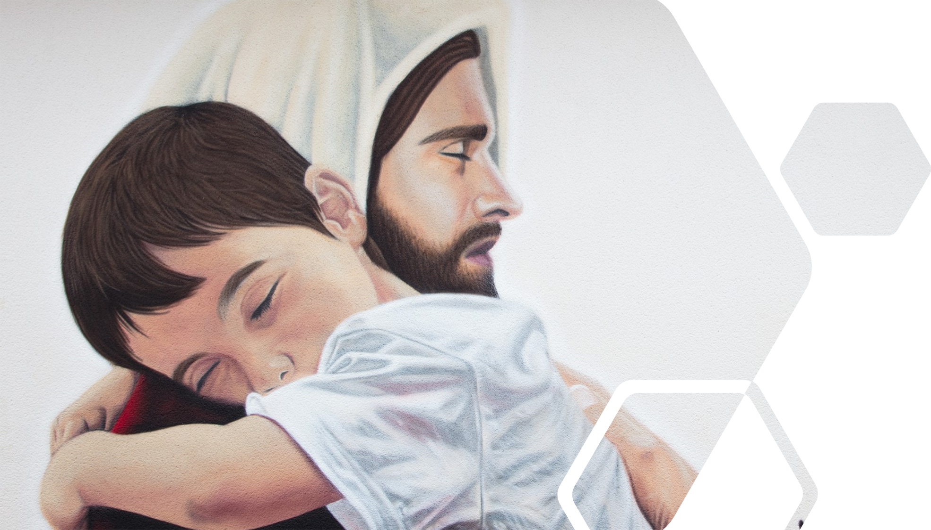
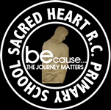
UNITE
YEAR 4 SPRING 2023: Candlemas & Lenten Terms
Staff members who work closely with your child:
Important dates for your diary this term: Unite Gathering: Monday 30th January 2023 Music Recitals: Wednesday 15th February 2023 and 29th March 2023. Celebrate: 13th January, 27th January, 10th February, 3rd March and 17th March 2023. Achieve opportunity to meet Pastoral lead / Inclusion & SEND lead: 26th January, 28th February, 27th March, and 28th April 2023. Parent/Teacher/Child Evening (Achievement, Wellbeing and Development Reviews): 8th March 2023 | Key information for this class: PE days Outdoor – Monday – both classes Indoor – Wednesday 4W – Thursday 4C Reading books are changed on: Monday. Please ensure you check and sign your child's reading record when you have read with them. Encourage children to write in their own diary. Spelling test day: Friday Homework given on: Monday & due in on: Friday Useful websites: My Maths, TT Rock stars Spelling Shed
How can we unite to support learning this term? Please try to ensure that your child accesses TT Rockstars regularly at home to build up pace and fluency in preparation for the times tables check in the Summer. A weekly update, the Sacred Heart Standard, is uploaded to our website each Friday and a link is text to those registered with our text messaging service. Do not miss this important weekly newsletter. https://www.sacred-heart.bolton.sch.uk/newsletters/

Slide 2
UNITE
YEAR 4 SPRING 2023: This term we are learning about…
Curriculum: Further information on our curriculum intent and the curriculum in each subject is available on our school website: https://www.sacred-heart.bolton.sch.uk/curriculum-map/
RE: Community UNIT 4: LOCAL CHURCH: COMMUNITY (Sp1 W1) What makes ‘community’? Community, commitment, responsibility, parish, laity, ministries, Extraordinary Ministers, service, funeral sites, pastoral area, deanery UNIT 5: EUCHARIST: GIVING AND RECEIVING (Sp1 W5) What’s more important – giving or receiving? Communion, community, giving, receiving, Liturgy of the Word, Penitential Act, Lamb of God, Concluding Rite, Sign of Peace, Introductory Rite, Eucharist, Communion Rite. UNIT 6: LENT/EAST ER: SELFDISCIPLINE (Sp2 W3) Is self-discipline important in life? Self-discipline, effort, potential, penance, contrition, Lent, Easter, Resurrection, fasting, alms giving | English: Spring 1 – Poetry, Instructions, Narrative Spring 2 – Description, Speech Writing Objectives Identify audience and purpose organising paragraphs around a theme using simple organisational devices [for example, headings and sub-headings] Use different nouns to make writing exciting The prefix sub super anti and auto Dictation Proof reading and editing Use a range of sentences with different forms – statements, questions, exclamations, commands and speech. Fronted adverbials and adverbs and prepositions for time, place and cause Use of a comma to mark fronted adverbials heel/heal/he’ll, knot/not, mail/male, main/mane, meat/meet, Words with th ei sound spelt ey, eigh or ei The suffix –ous Introduce the conjunctions while and unless yet, so The suffix -sion –tion –cian –ssion The suffixes –ly and -ally brake/break, fair/fare, grate/great, groan/grown, here/hear, Handwriting (see handwriting policy) Books – Max and the Millions, Who is Looking at the Moon Tonight, The Queens Nose, From a Railway Carriage | Maths: Multiplication and Division Number, Multiplication and Division continued (Week 1) Measurement and Area: (Week 2) Number: Fractions (Week 3-4) Number: Fractions (weeks 1-3) Decimals (Weeks 3-5) Multiplication Check practice daily* Assessment Week (2 lessons) | Science: Living things and their habitats Working Scientifically Skills: Big question: What would the impact on the planet be if all non-reusable plastic was banned? Key vocabulary: classification, classification keys, environment, habitat, human impact, positive, negative, migrate, hibernate Visitor: Richard Garriot Zoom with a link to ocean Animals Including Humans Working Scientifically Skills: Identifying, classifying and grouping. Setting up simple practical enquiries, comparative and fair tests. Use results to draw simple conclusions, suggest improvements and raise further questions. Big question: What would happen if we stopped looking after our bodies? Key vocabulary: digestive system, digestion, mouth, teeth, saliva, oesophagus, stomach, small intestine, nutrients, large intestine, rectum, anus, teeth, incisor, canine, molar, premolars, herbivore, carnivore, omnivore, producer, predator, prey, food chain

Slide 3
UNITE
YEAR 4 SPRING 2023: This term we are learning about…
Curriculum: Further information on our curriculum intent and the curriculum in each subject is available on our school website: https://www.sacred-heart.bolton.sch.uk/curriculum-map/
Computing: PM – Unit 5 Using logo (3 Weeks) To learn the structure of the language of 2Logo. To input simple instructions in 2Logo. To use 2Logo to create letter shapes. To use the Repeat command in 2Logo to create shapes. To use and build procedures in 2Logo. Nao robot unit (2 Weeks) Motion and movement - Sit, stand and walk Big question (1 Week) Could a robot ever be a convincing actor? Word (2 Weeks) Using word Typing Bullet points Tables Image text wrapping Spell checker PowerPoint (2 Weeks) Adding new slides Slide design Animations Transitions Adding images 3D PRINTING: (2 Weeks) Simple shapes - Create an Iron Giant | Art & Design: Focus: Roman Mosaic Artist: Amanda McCrann / Roman Art Key Skills: Mosaic collage / portrait Media: Graphite, paper, glue, magazines Formal Elements: Shape, form, line, texture, colour pattern. Big Questions: Why is Roman Art still important today? Did Jesus appreciate Roman Art? Artist in Residence: Dave Partington | Design & Technology: Textiles – make a tote bag. Research – Research different bags and their purposes. Skill Practice – practice tie dying a piece of material and attaching two pieces of material together. Design – Designer a tote bag (use inspiration from fashion designer Coco Chanel). Make – Make a tote bag which is reusable. Evaluate - How affective was this design? Big Question: How did God design you to be unique? | Music: Songs of Protest Make up and perform an accompaniment to ‘Give Peace A Chance’ Topic Overview Children listen to different examples of protest song. They will then learn to: • move between chords I, IV, V and VI in the C major scale on keyboard with both left and right hand • play as an ensemble in time with others When they can do this, they will learn to play common chord progressions on the keyboard and xylophone which involve just 1 or 2 chord changes. They will then use this skill to prepare a performance of ‘Give Peace A Chance’ Element focus: Know that the number of semitones between the first and second note of the chord is the reason for the difference between major and minor chords Listening focus: Music of Protest – how does the composer make the protest clear? Big Question: Can a song change the world?

Slide 4
UNITE
YEAR 4 SPRING 2023: This term we are learning about…
Curriculum: Further information on our curriculum intent and the curriculum in each subject is available on our school website: https://www.sacred-heart.bolton.sch.uk/curriculum-map/
History: Anglo Saxons – Are written records a reliable source of historical understanding? Who were the Anglo-Saxons and why did they invade and settle in Britain? How well did the Anglo-Saxons get on with each other? What was life really like in Anglo-Saxon Britain? What did the Anglo-Saxons leave behind? | Geography: Earthquakes – Is it right to build vital resources on plate boundaries? The structure of the Earth. Features of a volcano. Famous volcanoes and earthquakes. Effects of volcanoes and earthquakes. Preparing for an earthquake. What it’s like living near a volcano. | French: Topic: Expressing opinions about likes and dislikes Functions: Expressing likes and dislikes (about food and toys) • Justification of opinions • Numbers 21–39 • Simple prices Grammar: C’est + adjective • avoir: negative je n’ai pas • de after negative Core Language: • J’adore • Je déteste • ça • vingt-et-un, vingt-deux, vingt-trois, vingt-quatre, vingt-cinq, vingt-six, vingtsept, vingt-huit, vingt-neuf, trente, etc • C’est combien? • un euro • C’est super, magnifique, fantastique • Je n’a Phonics: • in • Revision of nasal sounds | Physical Education: Spring 1 Teacher- Send and Receive Coach – Rugby Skills Spring 2 Teacher - SAQ Coaches – Dance

Slide 5
UNITE
YEAR 4 SPRING 2023: This term we are learning about…
Curriculum: Further information on our curriculum intent and the curriculum in each subject is available on our school website: https://www.sacred-heart.bolton.sch.uk/curriculum-map/
PSCE & RHE: Unit 3: Emotional WellBeing Session 1: What am I feeling? Session 2: What am I looking at? Session 3: I am thankful! Unit 4: Life Cycles Session 1: Life cycles Lower Key Stage Two Module Two: Created to Love Others Unit 1: Religious Understanding (5x15min sessions) Story sessions Unit 2: Personal Relationships Session 1: Friends, Family and Others Session 2: When things feel bad | Educational Visits & Visitors: Monday 6th Feb and Wednesday 15th February Computing trip Late March – Walk around Westhoughton linked to Local History. Exact date TBC .

